Slide 1


Slide 2
Agenda
Executive Summary
Testing on different environments
2016 Releases
States Rolled Out
Automation %
Root Cause Analysis
Regression Cycle Time over the releases
Regression average execution time per test case (in Sec)
Next steps

Slide 3
Executive Summary
Business objective of this program is to replace the current iSNAP and aSNAP Legacy customer applications .
Multiline Systems Integration vision is to enable Personal (Auto & Cycle) LOB Sales and service application to store and manage Policy and Client data locally instead of on the mainframe . VAM Teams have supported CNBC , CNBA , ANBC , ANBA applications from 2012 to till date . Cycle Customer , Cycle Agent , Auto Customer have been rolled out completely and Auto Agent roll out is in progress .
Notes:
Mention about IN 1, UT1 etc

Slide 4

Timelines
MSI time lines for all projects with Start date and predicted End date
Cycle Customer
07-12-2012
Aug-2013 ,Cycle Customer
12-31-2016
Cycle Agent
10-22-2012
Mar-2014 ,Cycle Counselor
02-07-2015 , ANBC Go Live
12-31-2016
Auto Customer
12-31-2016
03-19-2013
08-02-2015 , ANBA Go Live
Auto Agent
12-31-2016
09-12-2015 , Esign Go Live
Onboarding
04-01-2015
12-31-2016
TM Regression
09-01-2015
Auto Prod Support
02-07-2015
12-31-2016
02-07-2015
12-31-2016
Auto Roll Out
Jan’16
Sep’16
Complete
Jun’ 15
Nov’ 15
Oct’ 14
Jan’ 15
In-Process
Dec’ 13
Mar’ 14
Production
Mar’ 13
Sep’ 13
Dec’ 12
July’12

Slide 5
Testing on different environments
INTG / USER / FT
Functional Testing (Prod Supp & Roll Out)
Regression Testing
TRNG
Verify if an issue exists in Prod
System Down Testing for every APD
DEV / SI / Patch
Smoke Testing
Spot Check
Functional Testing (Roll Out)
Some of the testing team activities include
Requirements analysis
Test Design
Peer Reviews
Identify capacity
Plan for the sprint / release
Defect Triage
Identify regression candidates
Testing Activities Cntd..
Review tests with Regression Review Board
Automate Regression candidates
Perform FNST
Coordinate System Down Testing
Perform Mobile Regression
Reporting
Enhancing RCA Categories (work in progress)
Notes:
Mention about IN 1, UT1 etc

Slide 6
2016 Releases
IT NB Releases
Magic Releases
Mobile First team has been merged with Prod Support team after July FT
ANBC & Cycle currently working towards Nov APD
ANBA currently working towards Nov APD and Dec APD

Slide 7
ANBA Rolled out States
States Rolled Out
AL, GA, WI, MO, IN, FL
Plan for Roll out in Nov
MD, IL, LA, KY, OH, MO, MN
9 Agents are using the ANBA application currently across all 6 rolled states

Slide 8
ANBC Rolled out States
0% States
Region 1: PA, MD Region 2: NY Region 3: LA, TN Region 4: CA Region 5: TX Region 6: FL Region 7: NC, VA Region 8: CT, NJ, MA Region 9: IL, OH Region 10: WA, AZ, NV
50% States
Region 3: GA, MS, SC, AR Region 4: HI Region 5: CO, IA, ND, NE, OK, SD, WY, KS Region 8: VT Region 9: KY, MN
100% States
Region 1: DC, DE, WV Region 3: AL Region 4: AK Region 5: NM Region 8: ME, RI, NH Region 9: IN, MI, MO, WI Region 10: ID, MT, OR, UT

Slide 9
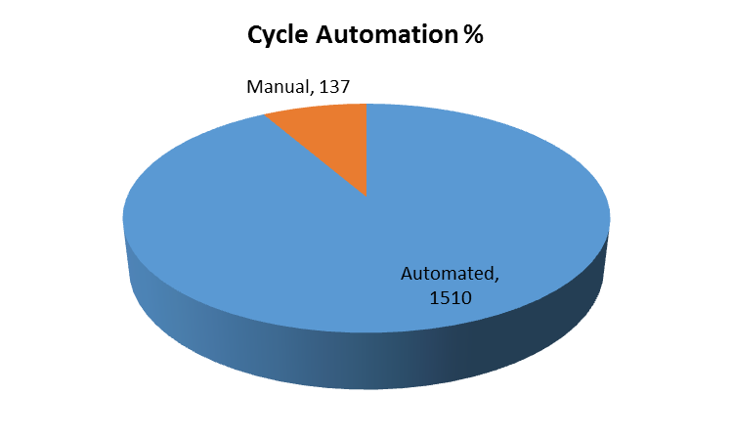
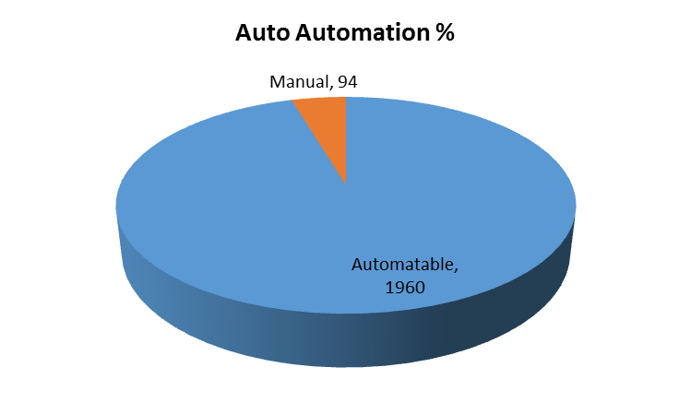
Automation %
Available Conditions – 1647
Automated Conditions – 1510
Manual Conditions – 137
Automatable Conditions – 1510
Available Conditions – 2054
Automatable conditions – 1960
Automated Conditions – 1960
Manual Conditions – 94
All automatable test conditions are automated
Tests are automated after Review is completed with Regression Review Board

Slide 10
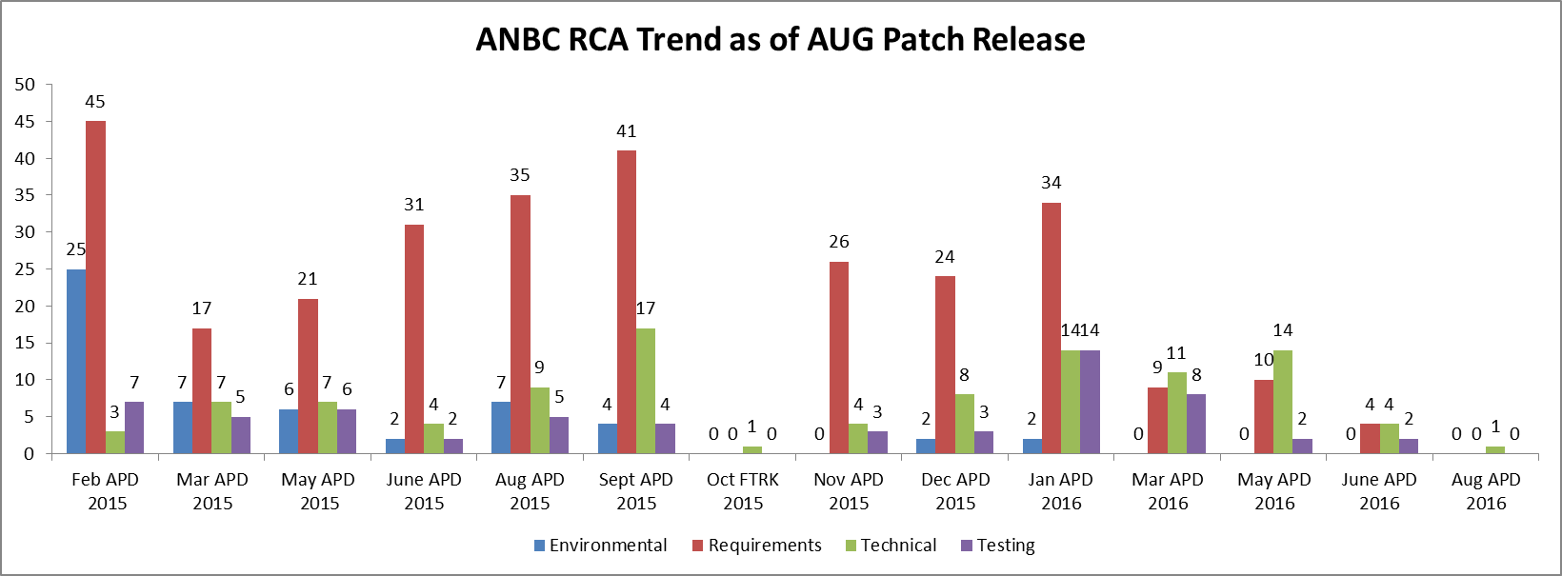
Root Cause Analysis – ANBC
Testing Root Cause has been coming down over the releases
Showstopper and Critical JIRAs resulted in efix earlier in 2016. We are working on the nature of these severity so as to have necessary coverage in our regression suite

Slide 11
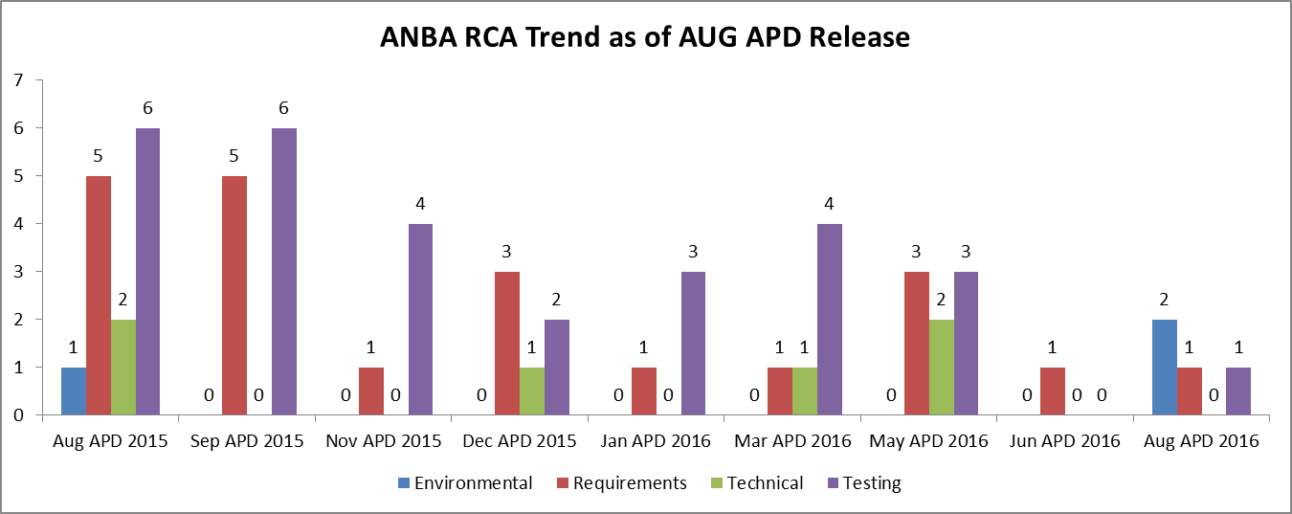
Root Cause Analysis - ANBA
- Initial releases saw critical JIRAs of Testing trending high which has come down over the releases

Slide 12
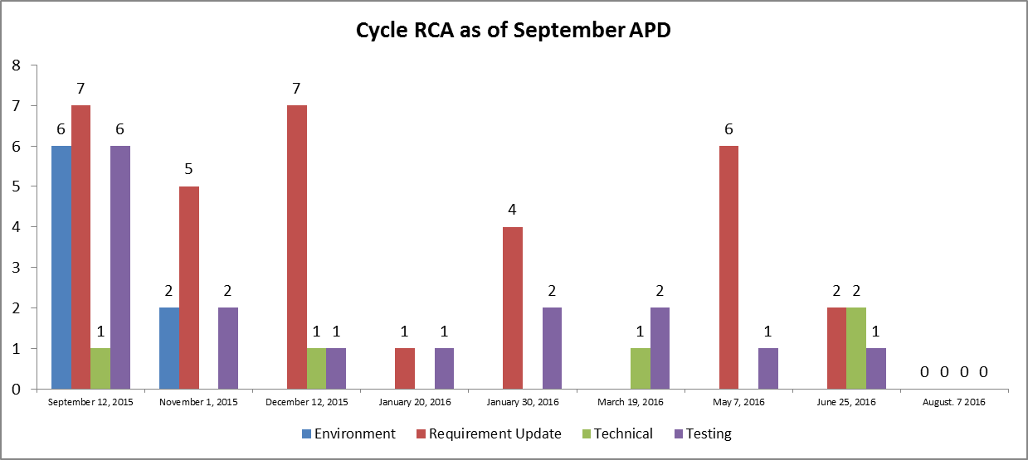
Root Cause Analysis – Cycle
Notes:
Aug APD and Sep APD have 0s or some other respresentation

Slide 13
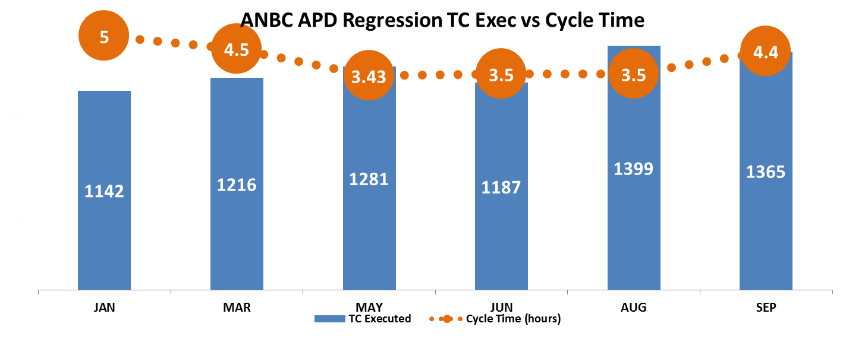
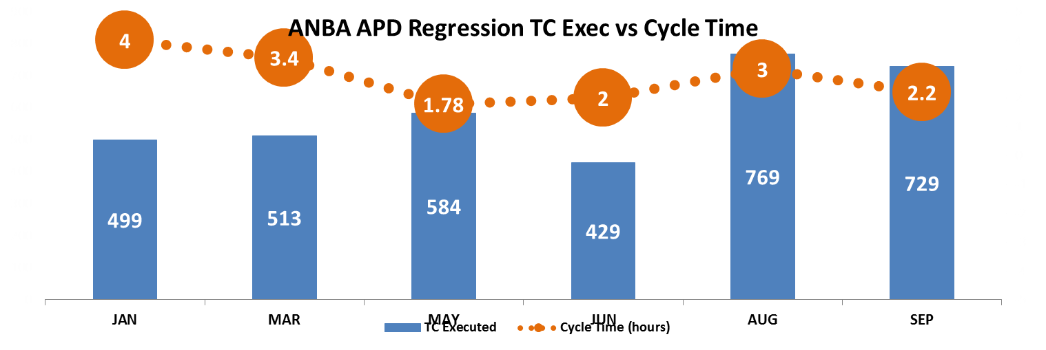
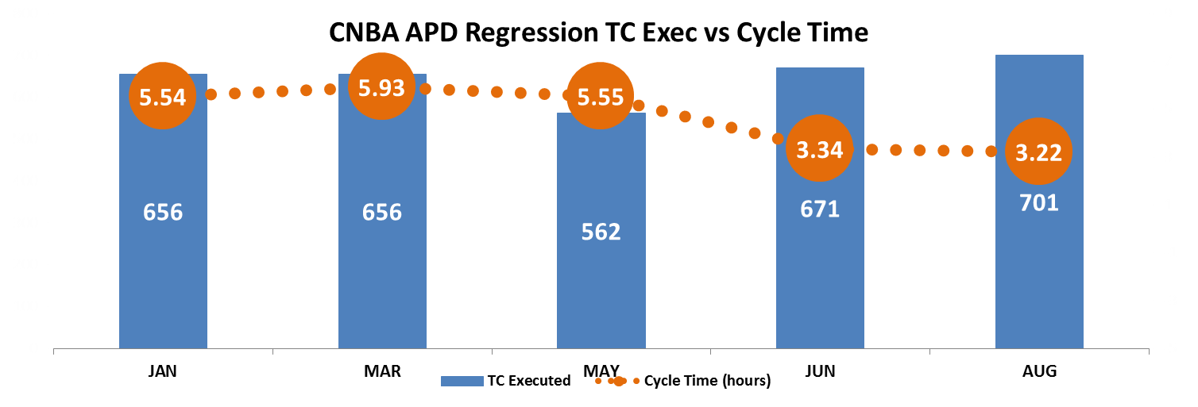
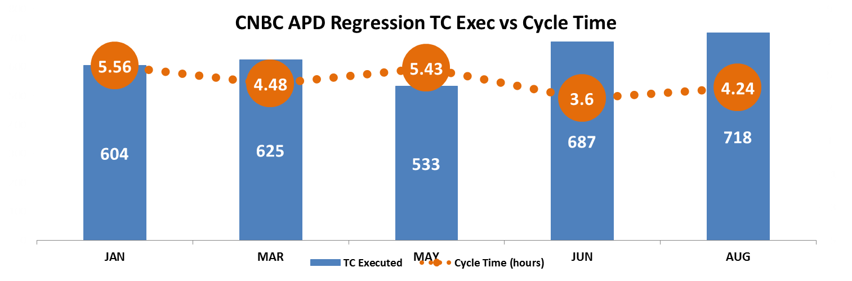
Regression Cycle Time over the releases
The time taken to execute automated test cases has been coming down over the releases
ANBC cycle time has gone up in the last release due to application issues which resulted in re-execution

Slide 14
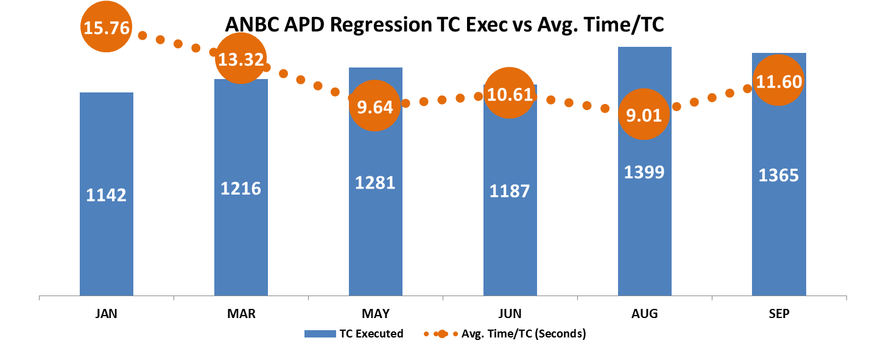
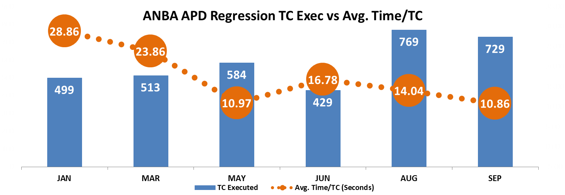
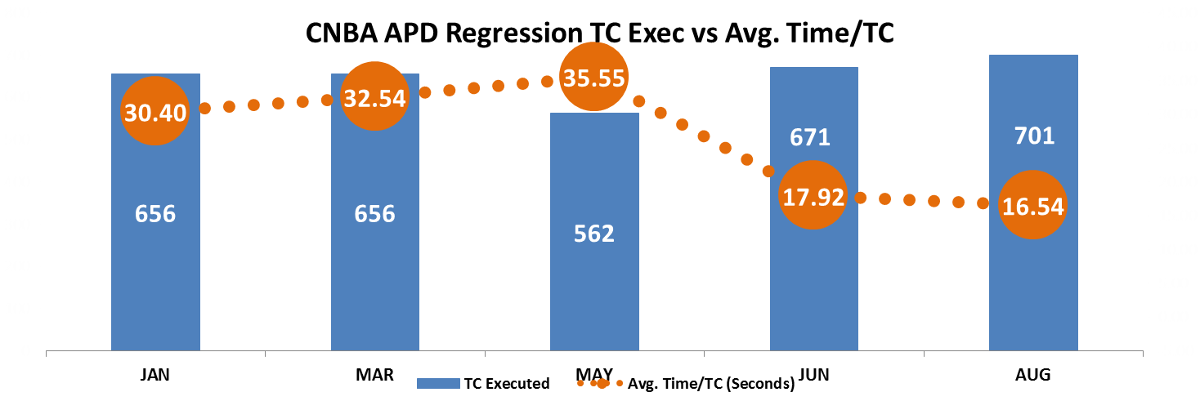
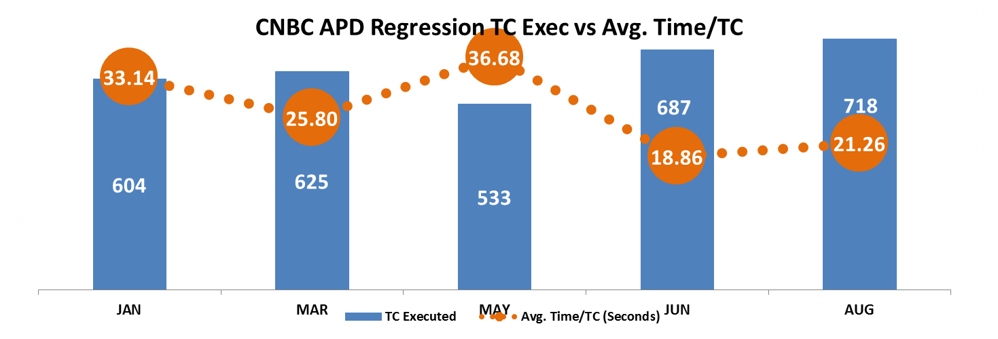
Regression average execution time per test case (in Sec)
Average time taken to execute is the total tests executed / effort (in Sec)

Slide 15
Next Steps
Continuous Testing
Phase 1
Continuous Smoke Testing (11/15/2016)
Phase 2
Continuous Regression Testing (1 Q 2017)
Trigger Smoke Test after each build deployment automatically
Smoke Results to be send to stakeholders
Collaborate with CM Team to enable automated running of Smoke Tests after build deployment
Identify test data independent , business critical automated regression cases (11/30/2016)
Enable framework to trigger Smoke Tests after build deployment and send results to distribution list. (11/30/2016)
Collaborate with CM Team for feasibility of integration of Continuous regression with Build Deployment process (12/31/2016)
Running continuous regression for Auto and Cycle customer and Counselor application (3/31/2017)
Improve Cycle Time for Regression
Optimize the regression suite by identifying non critical cases and exclude those which have been passing for the last couple of releases
To identify the bottle necks in regression execution on a daily basis and try to resolve them so that we don’t have many failures in regression execution

Slide 16

THANK YOU!
ASIA PACIFIC
Plot No 36 & 37, Gachibowli,
Financial District, Nanakramguda,
Hyderabad – 500032, India
US HEADQUARTERS
220 Old New Brunswick Rd,
Suite 100,Piscataway 08854
T: 908-755-0105

